Slide 1

What is Caching?
In computing, a cache is a high-speed data storage layer which stores a subset of data, typically transient in nature, so that future requests for that data are served up faster than is possible by accessing the data’s primary storage location. Caching allows you to efficiently reuse previously retrieved or computed data.
So the key points are:
Reuse of previously retrieved data
Faster access
Prevents recalling database again and again

Slide 2
What's the Benefit of Cache?
Caching reduces the latency and contention of handling large volumes of concurrent requests to a data store. As data volume and the number of users increase, the greater the benefits of caching become. Caching is most effective when a client repeatedly reads data that is immutable or that changes infrequently.
For example, let’s think about an Online Toy Store named XY Toy Store. If someone browses the website again and again it needs more CPU power and bandwidth.
But with caching enabled for a given user volume we can get away with just 20% of the hardware originally needed and half the external network bandwidth. So if I originally needed 10 CPUs and 8Mbit internet link I can now run on 2 CPUs and a 4Mbit internet link.

Slide 3
Top 10 Open Source Caching Tools for Linux in 2020
Redis
Memcached
Apache Ignite
Couchbase Server
Hazelcast IMDG
Mcrouter
Varnish Cache
Squid Caching Proxy
NGINX
Apache Traffic Server

Slide 4
What is Memcache?
Simple in-memory caching system
Can be used as a temporary in-memory data store
Stores data in-memory only
Excellent read performance
Great write performance
Data distribution between multiple servers
API available for most languages

Slide 5
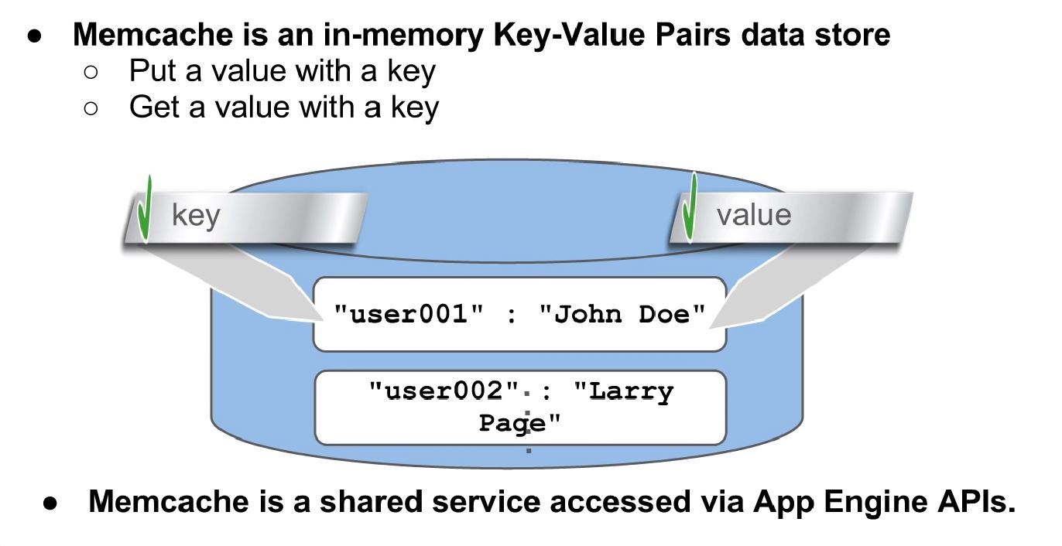
Memcached can store any object
•Simple String
•Hash
•Other
•Strings can be read / written among heterogenous systems.

Slide 6
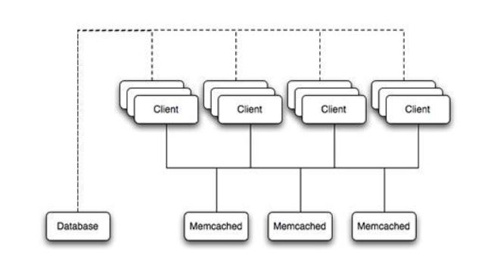
This is an example structure of Memcached. Any of the clients can contact one of the Memcached servers to request a given key. Each client is configured to talk to all of the servers shown in the above diagram.

Slide 7
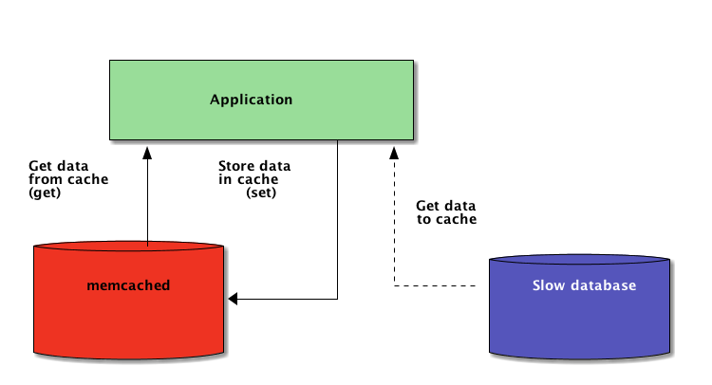
Why do we use Memcache?
Improve application Performance
Reduce application cost

Slide 8
What do we use Memcache for?
Caching - Datastore query results - User authentication token and session data - APIs call or other computation results.
Sharing data cross app interfaces

Slide 9
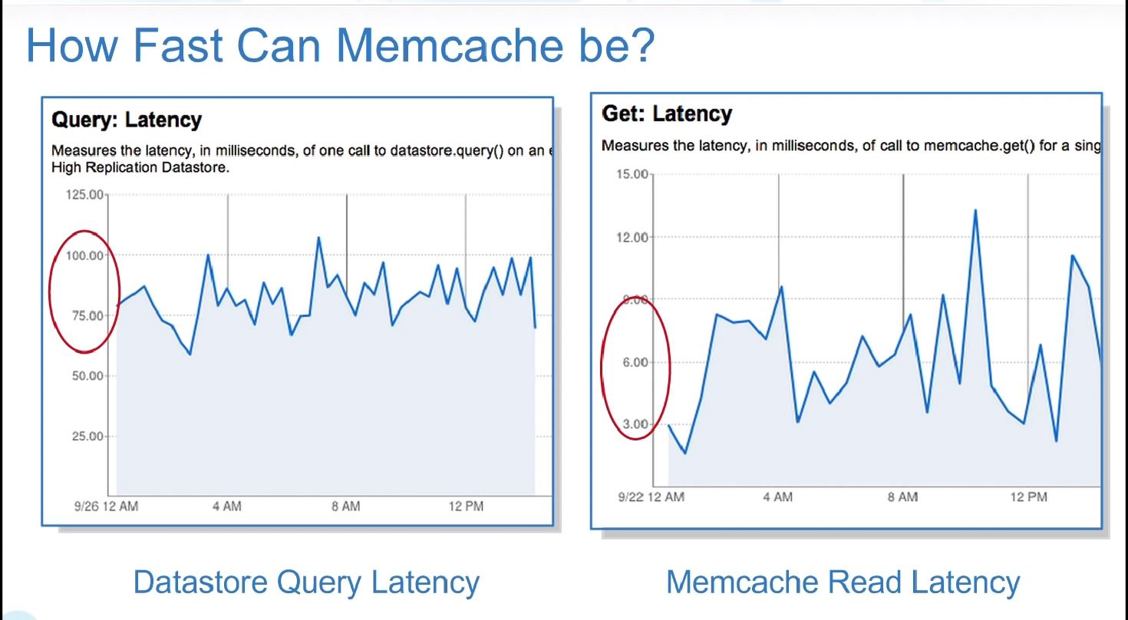
Memcache is 10 times faster than datastore. Datastore took 100 ms to retrieve data and Memcache took less than 10 ms in average.

Slide 10
How much costly is Memcache?
The answer is Zero(0). Memcache is absolutely free. For the database query we have to pay for it. For the API calls, we have to pay for it.
If the 90% of the requests can be handled by Memcached and there is no need to go to the datastore or no need to call the APIs, that could be a huge save for our applications.

Slide 11
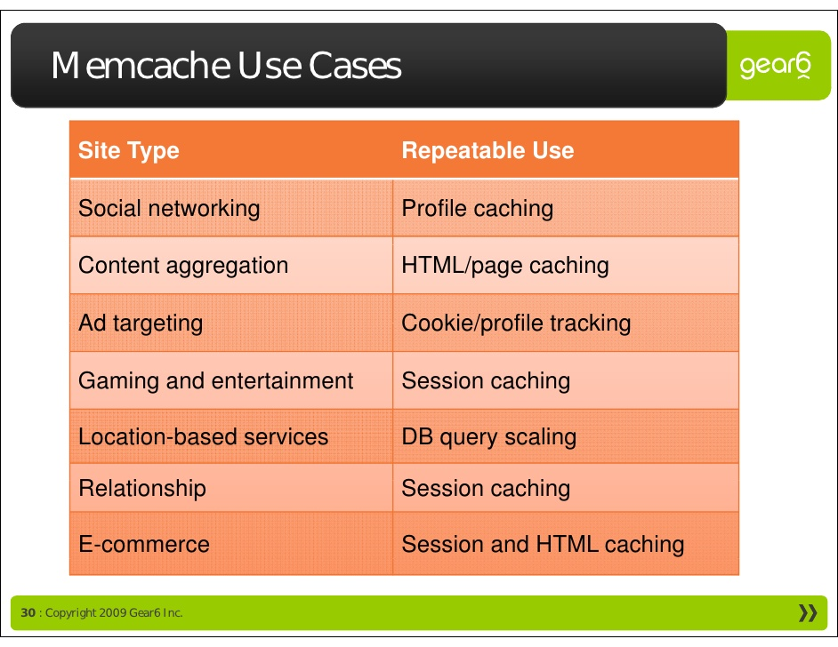
Some use cases
Anything what is more expensive to fetch from elsewhere, and has sufficient hit rate, can be placed in Memcached
Web Apps that require extremely fast reads
Temporary data storage
Global data store for your application data
Session data (ROR)
Extremely fast writes of any application data (that will be committed to an actual data store later)
Memcached is not a storage engine but a caching system

Slide 12
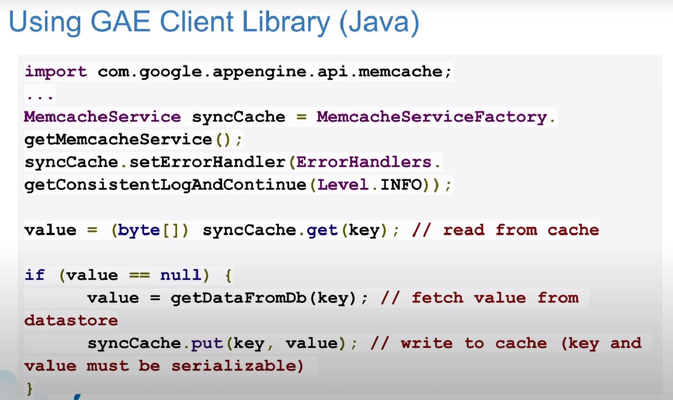
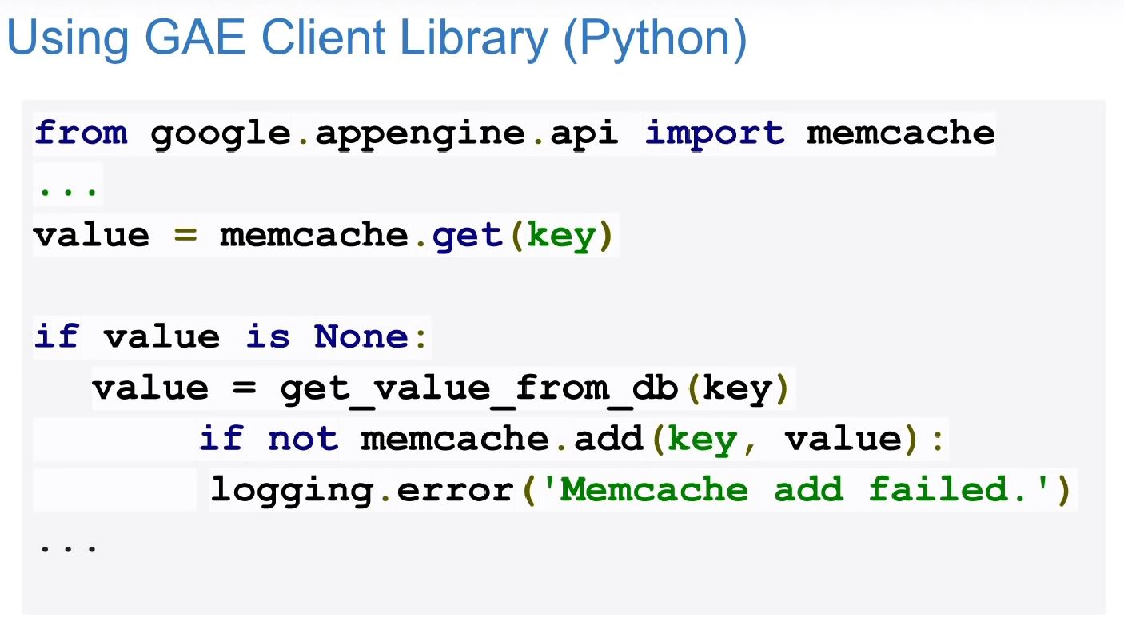
How to use Memcache?
Memcashe APIs
Java - JCache APIs - GAE Low-Level Memcache APIs - Objectify for Datastore
Python - google.appengine.api.memcache module - ndb for Database

Slide 13
Memcached Server Info
Memcache server accepts read / write TCP connections through a standalone app or daemon.
Clients connect on specific ports to read / write
We can allocate a fixed memory for memcached to use.
Memcached stores data in the RAM (of course!)
Memcached uses libevent and scales pretty well (theoritical limit 200,000)

Slide 14
Some Memcache Commands
Storage Commands
Set – Most common command to store data. It can also overwrite existing data.
Add – Stores only current data if no data exists
Replace – If there is any existing data then it is used to replace that and store.
Append – adds data after the last byte in an existing item.
Prepend – same as append but adds data before a byte.
Cas – check and set or compare and swap. An operation to store data only if no one else has updated the data.

Slide 15
Some Memcache Commands(ctd..)
Retrieval Commands
Get – command for retrieving data. Takes one or more keys and returns all found items
Gets – an alternative get command for using with cas. Returns a CAS identifier with the item.
Delete- removes an item from the cache if it exists.
Incr/decr – increment and decrement. If an item stored is the string representation of a 64bit integer, we may run incr or decr commands to modify that number using only positive value.
Stats – stats is a basic command
Stats item – returns some information about item stored in Memcached.
Stats slabs – returns more information from Memcached rather than counting of particular items.
Stats sizes - A special command that shows us how items would be distributed if slabs were broken into 32byte buckets instead of our current number of slabs. Useful for determining how efficient our slab sizing is.
Flush_all – invalidate all existing cache items

Slide 16
Limitations of Memcached
It is a limited resource
We can not put everything of database in the memcache
We only have to put what is useful and necessary.
We cannot use a partitioned table for data queried or stored through the Memcached interface.
All fields mapped with memcache has to be varchar.
Complex queries can not be performed using memcache plugin.
Aggregation operation can not be performed through memcache plugin.
Security Concerns - In February 2018 cloudflare reported that misconfigured Memcached server were used to launch DDoS attacks in large scale. Though it was mitigated in memcashed version 1.5.6 disabling UDP protocol.

Slide 17
What is Redis??
Redis is an open source in-memory data structure store.
It is also a Key Value data structure store.
Redis can be used as Database, Caching or Message-Broker.
Redis is written in C.
Redis provides data structures such as strings, hashes, lists, sets, sorted sets with range queries, bitmaps, hyperloglogs, geospatial indexes, and streams.

Slide 18
Benefits of Redis
Redis is Fast. Beacuse it is an in-memory data-structure.
It is open source an also well documented.
Structure is very simple.
No schemas and column names unlike SQL.
Supports multiple data structures.
Supports automatic operation on data types.
Replication and Persistance.
High availability and scability.
Extensibility.

Slide 19
Redis & Security
Designed to be accessed by trusted cilents
Do not allow external access / internet exposure
Simple authentication can be setup
Can be restrcited to certain interfaces
Data encryption not supported

Slide 20
Who are using Redis??
Twitter
Weibo
GitHub
Pinterest
Snapchat
Stackoverflow
Flickr
Digg

Slide 21
Redis UseCase
Caching
Chat,messaging and queues
Gaming leaderboard
Real-time analytics
Session store
High IO workloads
Geospatial
Machine Learning
Pub /Sub

Slide 22
Redis Supported Languages
Python
Java
Ruby
PHP
Perl

Slide 23
Redis vs Memcached
Redis | MemCached
1. An open cource in memory data structure store. used as database, cache and message broker. | 1. An open source and free distributed memory object caching.
2. Easy to use. | 2. Not easy to use.
3. Can handle persistent data | 3. Can not handle persistent data.
4. Supports string , hashes, lists, sets. sorted sets, bitmaps, and many more. | 4. Supports strings ans integers only.

Slide 24
Redis Features
Versatile Data Structure
Lua Scripting
Transaction
On-disk Persistence
Replication
Automatic Partioning with Redis Cluster
Automatic Failover

Slide 25
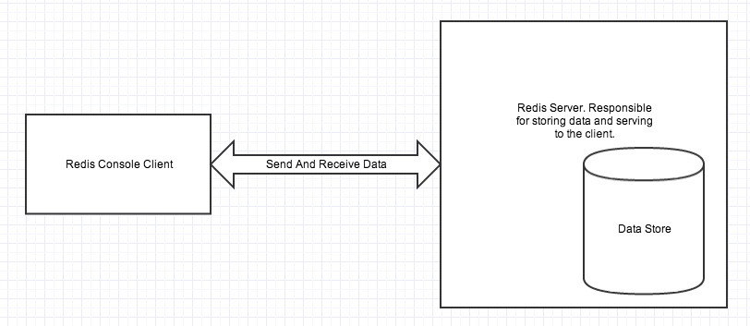
Redis Architecture
Redis architecture contains two main processes: Redis client and Redis Server.

Slide 26
Redis Persistence
Redis provides two differnet types of mechanism to deal with persistence.
Those are:
Redis Database Snapshot(RDB)
Perfoms point-in-time snapshots of a dataset at specified intervals.
Append of files (AOF)
AOF persistence logs every write operation received by th server
It is possible to combine AOF and RDB.

Slide 27
RDB
Advantage OF RDB:
Single file
Point to time
Suited well for backups
Good Performance
Disadvantage of RDB:
Not good when Redis stops wroking
Needs to fork very often in order to persist on disk using a child process
Can loose data for up to several minutes.

Slide 28
AOF
Advanatges of AOF
Have different fsynce policies.
It is an append only log.
Provides auto rewrite in background feature for Redis
Contains a log for all the operations
lose data for 2 second only
Disadvantage of AOF
Files are Bigger
Has more bugs

Slide 29
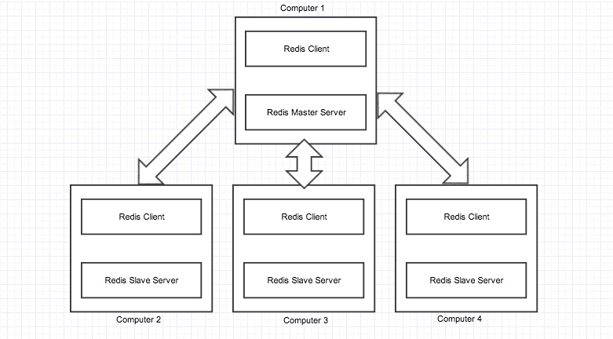
Redis Replication

Slide 30
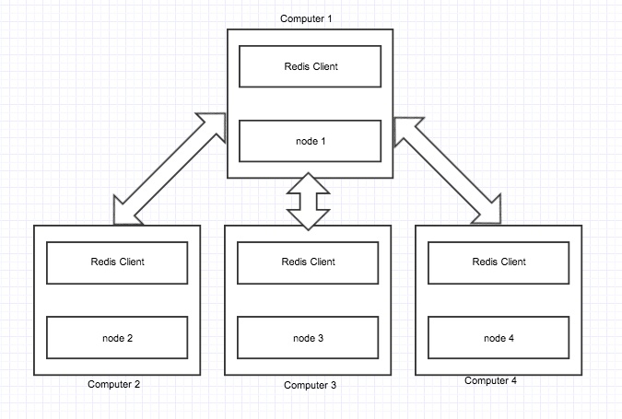

Redis Cluster

Slide 31
Azure Cach for Redis
What is Azure Cach for redis?
Azure cach for redis is a secure data cach and message broker service hosted by Microsoft.
It is a Platform as a Service
It Provide high throughput and low latency

Slide 32
Scenarios Supported by Azure
An in-memory data store
A distriburted non-relational database
A message broker
A configuration or discovery server

Slide 33
Azure Cache Features
Dedicated virtual machine per cache.
Sizes: 256MB, 1GB, 2.8GB, 6GB, 13GB, 26GB, 53GB.
Available in all Azure region.
It provides secure and dedicated Redis server instances and full Redis API compatibility.
Azure is accessible to any application within or outside of Azure.

Slide 34
Acknowledge to
Mushfikunnabi Nijhum – 17101142
Tasnim Alam – 17101265

